Slide 1

Intelligent Crop Recommendation System
Present By: (IT-7)
Usama Rafique-031
&
Kamran Ishfaq-035
Artificial Intelligence

Slide 2

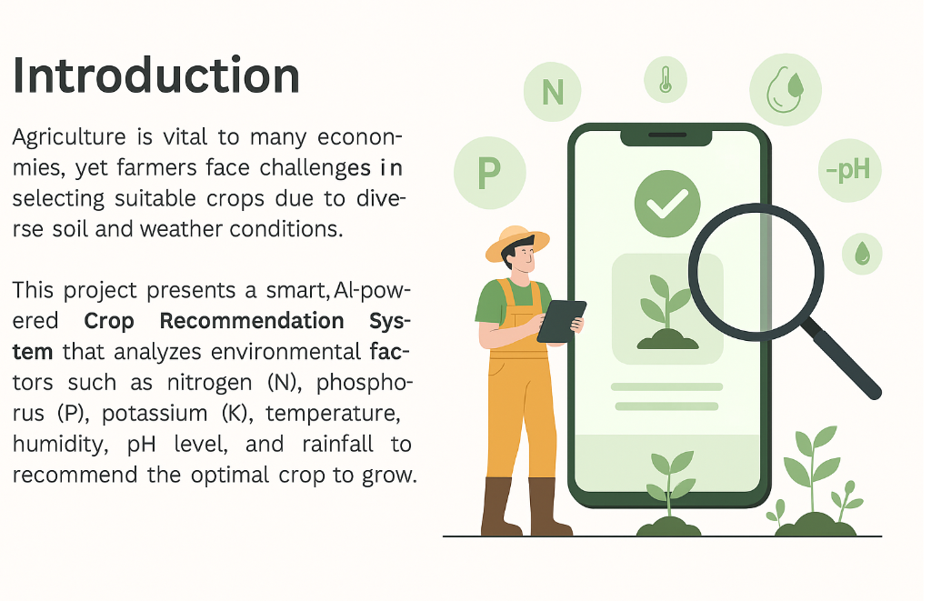
Introduction
Crop

Slide 3
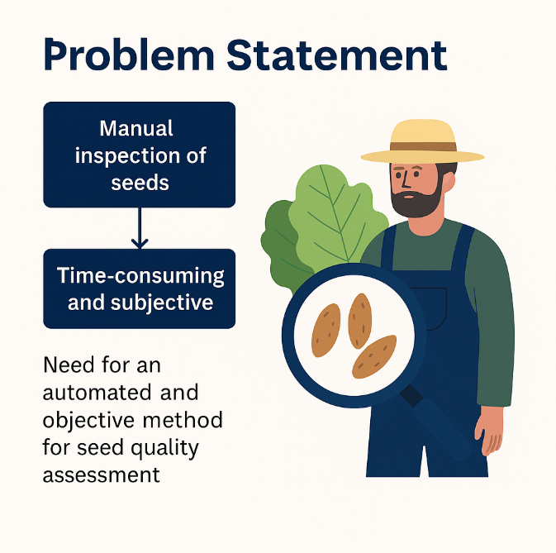
Problem Statement
Crop

Slide 4

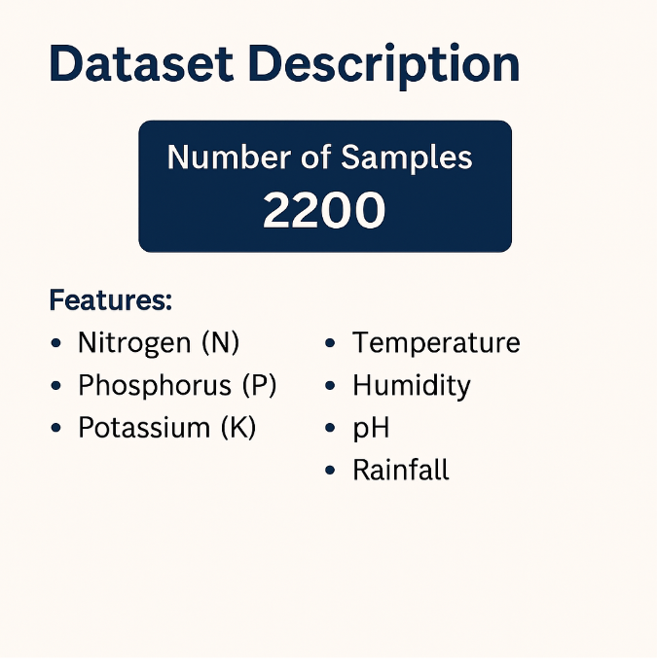
Dataset Description
CROP
The dataset used in this project is titled "Crop Recommendation Dataset" and is widely used in agriculture-based machine learning solutions. It is available publicly on Kaggle and commonly imported in Google Colab for model training and experimentation.

Slide 5
Dataset Description
Crop
Dataset contains 2200 records of 22 crops.
Features used: Nitrogen, Phosphorus, Potassium, Temperature, Humidity, pH, and Rainfall
Each row ends with the best crop label based on these values.

Slide 6
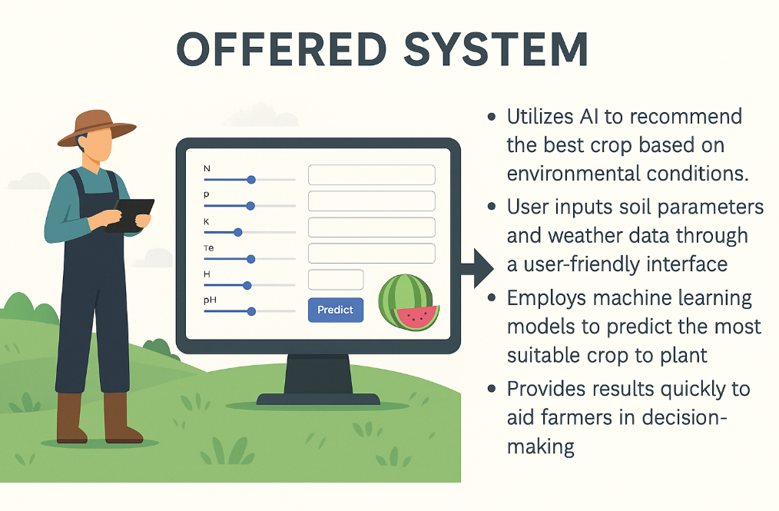
Crop

Slide 7
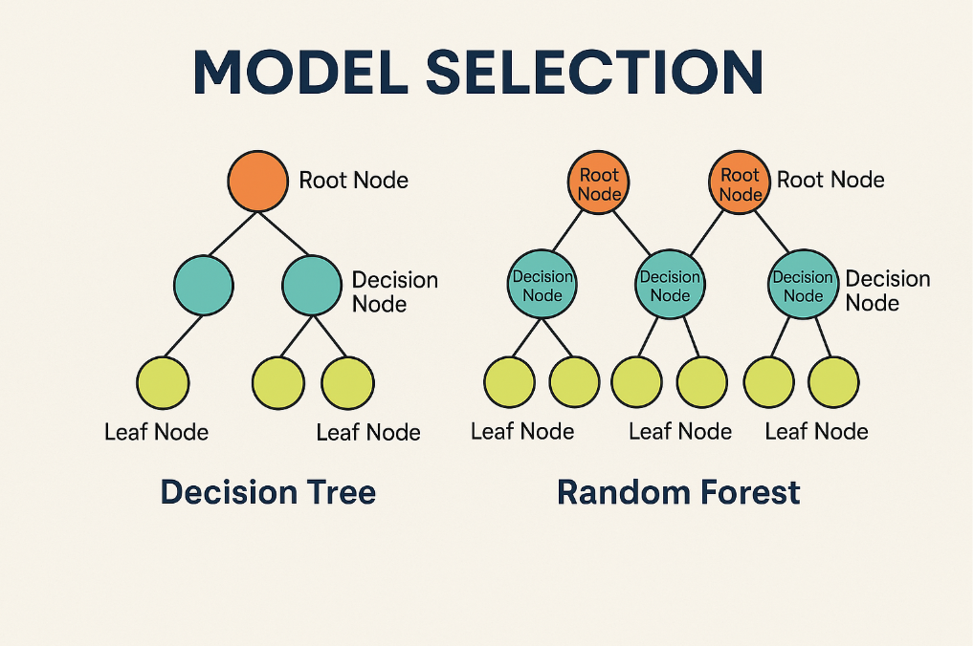
Crop

Slide 8
Model Selection
Crop
In this project, we experimented with multiple machine learning models to identify the most accurate and efficient algorithm for crop prediction.
The selection of the right model plays a critical role in ensuring high accuracy, precision, and reliability in agricultural recommendations.
We trained and evaluated the following models:
Decision Tree Classifier
Random Forest Classifier

Slide 9
How It’s effect on results
Crop
Decision Tree offers a fast, interpretable structure but is prone to overfitting in noisy datasets.
It achieved 98.7% accuracy on our dataset.
Random Forest is an ensemble method that combines multiple decision trees, reducing variance and improving generalization. It achieved 99.2% accuracy and outperformed others in terms of stability and real-world prediction

Slide 10
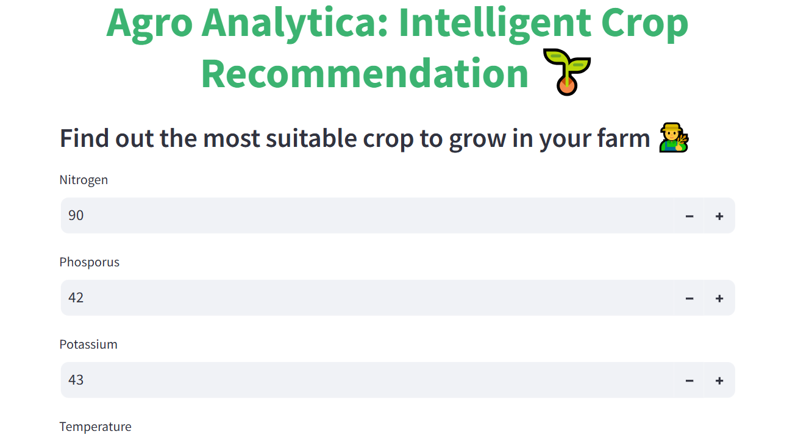
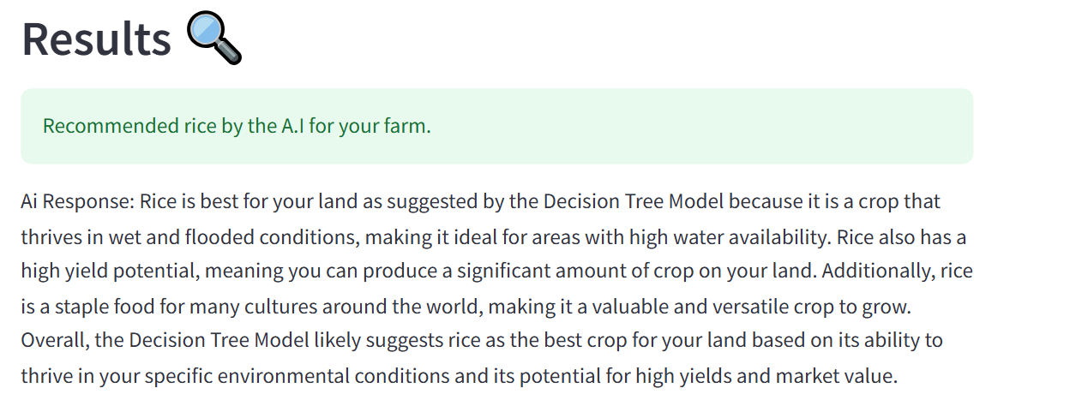
Replicate_app.py
Crop
- HTML form input to backend. - Predicts crop and shows output. - Suitable for web API integration or mobile apps. - Works as backend service.

Slide 11
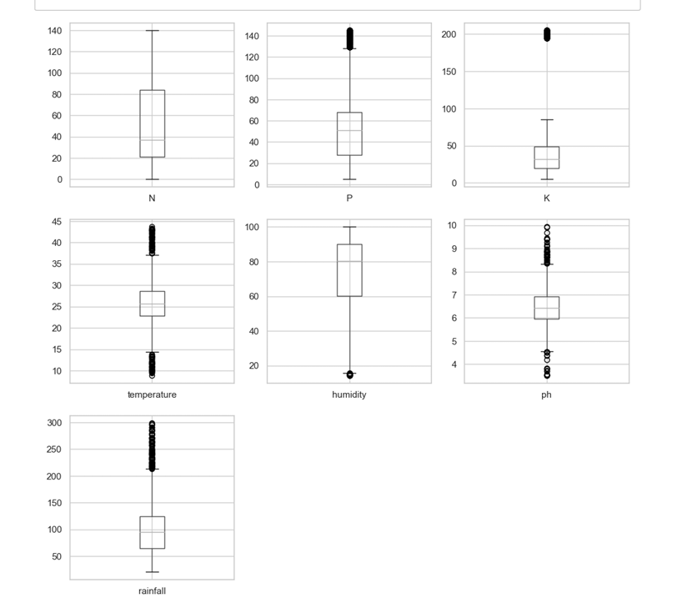
Model Output Example
Crop
.
- Input: N=92, P=42, K=43, Temp=21, Humidity=82, pH=6.5, Rainfall=202 - Prediction: Rice - Displayed via Streamlit or Flask interface. - Screenshot recommended in presentation.

Slide 12

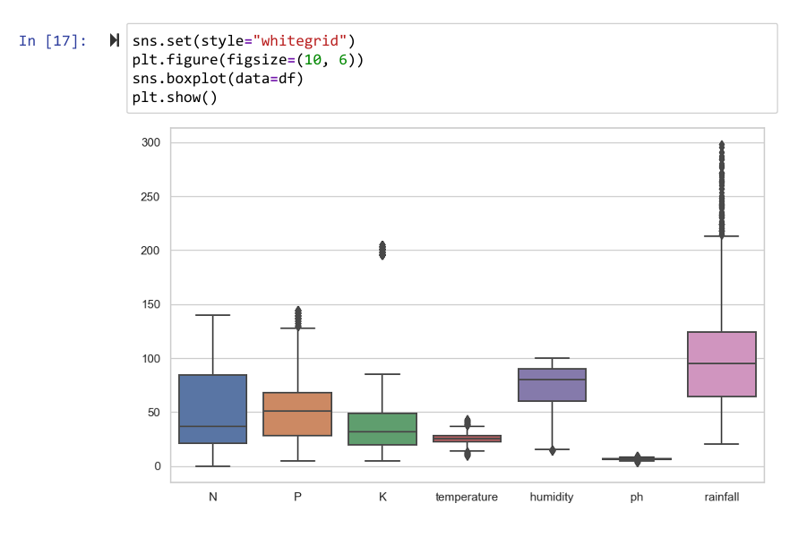
Model Output Example
Crop
- Input: N=92, P=42, K=43, Temp=21, Humidity=82, pH=6.5, Rainfall=202 - Prediction: Rice - Displayed via Streamlit or Flask interface. - Screenshot recommended in presentation.

Slide 13
Conclusion & Future Work
EQUIFAX
✅ 99.2% accurate system for crop recommendation ✅ Easy to use web interface for farmers ✅ Practical for decision making in agriculture 🔮 Future: - Mobile app - Weather API integration - Local language support

